Slide 1

Title: image – based text steganography using python
Name: Kirollos Hany
ID: 202400308

Slide 2
Abstract
Hides text in images using Least Significant Bit (LSB).
Input: image + message -> Output: image looks unchanged.
Decoding reverses process to shoe the message.
Pure Python, no extra libraries.

Slide 3
Introduction
Steganography: application hides data to keep it unseen.
Used in digital communication, watermarking, privacy apps.
Focus: hide data in images while it keeping it’s look.

Slide 4
Project Purpose
Hide secret messages in images using Python only.
Practice programming: loops, conditions, file handling, binary operations.
Learn basics without external libraries

Slide 5
How the App Works
Convert message -> binary.
Insert bits into LSB of pixels.
Add delimiter to mark message end.
Decode by reading LSBs -> reconstruct message.

Slide 6
Using the App
Hiding a Message:
Load image -> Enter message -> Save encoded image.
Extracting a Message:
Load image -> Decode -> Original message shown.
Error Handling:
Message too long, missing file, special characters handled.

Slide 7
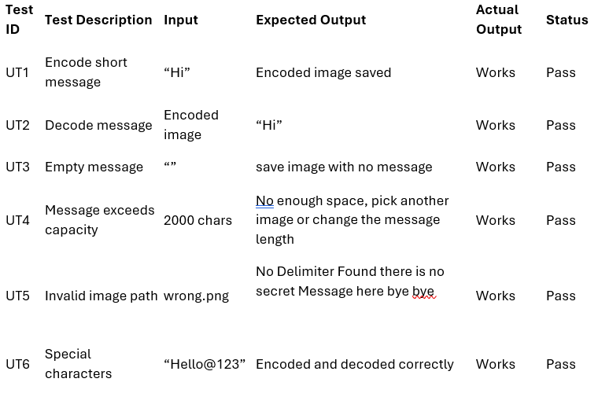

Slide 8
Overview
Encoding:
ASCII -> binary -> modify LSBs -> add delimiter -> save BMP.
Decoding:
Read LSBs -> detect delimiter -> 8Bit chunks -> ASCII -> message.
Linear time complexity O(n), preserves image quality.

Slide 9
Key Features And Challenges
Custom delimiter for message end.
Manual image byte handling and no libraries.
Maintains image quality.
Error handling: capacity, missing files, special characters.

Slide 10
Conclusion
Efficient Python steganography application.
Demonstrates hiding/retrieving messages without libraries.
Teaches binary manipulation, file handling, Python fundamentals.
Preserves image quality and ensures privacy.

